Slide 1
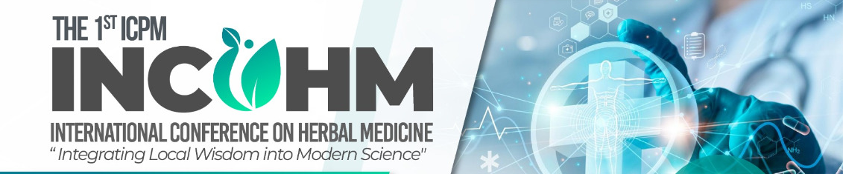
Title
Author/s
Please remove all text on this template before designing your Poster.
All digital posters must be submitted in .PDF format must not be larger than 10MB.
All digital posters must be submitted in 60:90 cm portrait orientation using the digital poster template. You are free to design your poster as you see fit, but the poster dimension and orientation must not be changed.
We recommend you use standard system fonts such as Calibri, Verdana, Times New Roman and Arial
Please be mindful of any copyright of photos/graphics used when creating your poster.
Font size for Titles/Headings and for text blocks should be readable for delegates. Note that font sizes under 28pt will be hard for other delegates to read.
Audio will not be available on digital posters.

